Slide 1
STADIUM SEAT BOOKING SYSTEM
Submitted in the partial fulfillment for the award of the degree of
BACHELOR OF ENGINEERING
IN
GAMING & GRAPHICS
Submitted by:
Swarup Deb
( 19BCG1077)
Under the Supervision of:
Sharanjit Kaur
Department of AIT-CSE
DISCOVER . LEARN . EMPOWER

Slide 2
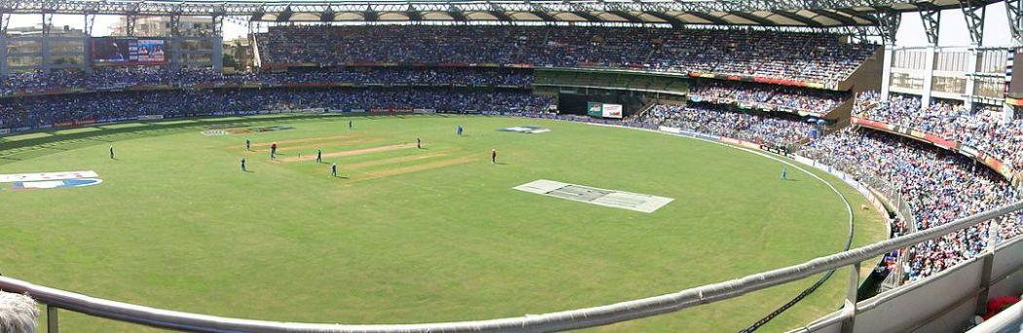
Outline
Introduction to Project
Problem Formulation
Objectives of the work
Methodology used
Results and Outputs
Conclusion
Future Scope
References

Slide 3
Introduction to Project
This research work was carried out because we believe that there are significant improvements that could be made to the current stadium seat booking system which would benefit the national stadium management team, saving them time and money, as well as the customers, the fans, who would find it easier to purchase and use their tickets, leading to an altogether more enjoyable match day experience, and, hopefully, more frequent visits to the stadium.
The National Stadium Management team is responsible for the day-to-day management and running of the stadium.
Buying tickets in person is by far the easiest way to purchase tickets, however many fans live outside of the area, or cannot get down to the stadium to purchase tickets in advance due to work.

Slide 4
Introduction to Project ( cont… )
To easy stadium seat booking task, there is need for a software system which must be created using well established principles of software engineering and latest technologies that guarantee a high degree of reliability and enhance ways of buying elsewhere, hopefully a larger number of people would buy in advance, easing the congestion.
The main aims of the project are to create a reliable and easy to use system which will simplify the stadium seat booking processes. A more efficient and modern entry system to the ground, which will reduce costs on a match-by- match basis. And to provide a fairer system for distributing away tickets.

Slide 5
Problem Formulation
As discussed earlier ,With the advancement in technological sector more and more work is done through smart machines.
The problem we encountered to come with this project was not in a single note and I would like present these problems.
The people wo are living far ashore from stadium dont have that much of time to buy tickets from there.
People may not find themself so trained for using sophisticated system for booking tickets.

Slide 6
Objectives
To work towards the elimination of ineffective modes of operation. It centers on the users having a good atmosphere to use the system.
To work towards combating all the problems discovered on the existing system.
Electronic security is maintained as the fans, customers and management are able to login and access the system depending on their privileges.
Safeguarding of information by not allowing user to register multiple times with same credentials.

Slide 7
Methodology used
Java will be used as a base programming language.
Different libraries will have to be installed on the Java Ide terminal to access the necessary resources.
The proposed system will be designed using Eclipse compiler for the interface design.
Xampp MySQL Server for database design and to create a server.

Slide 8
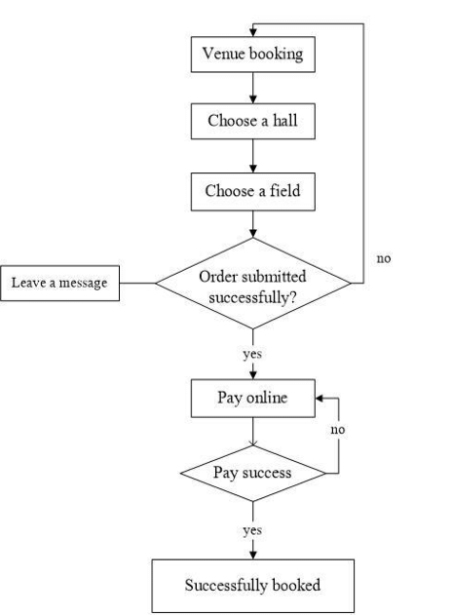
Flowchart

Slide 9
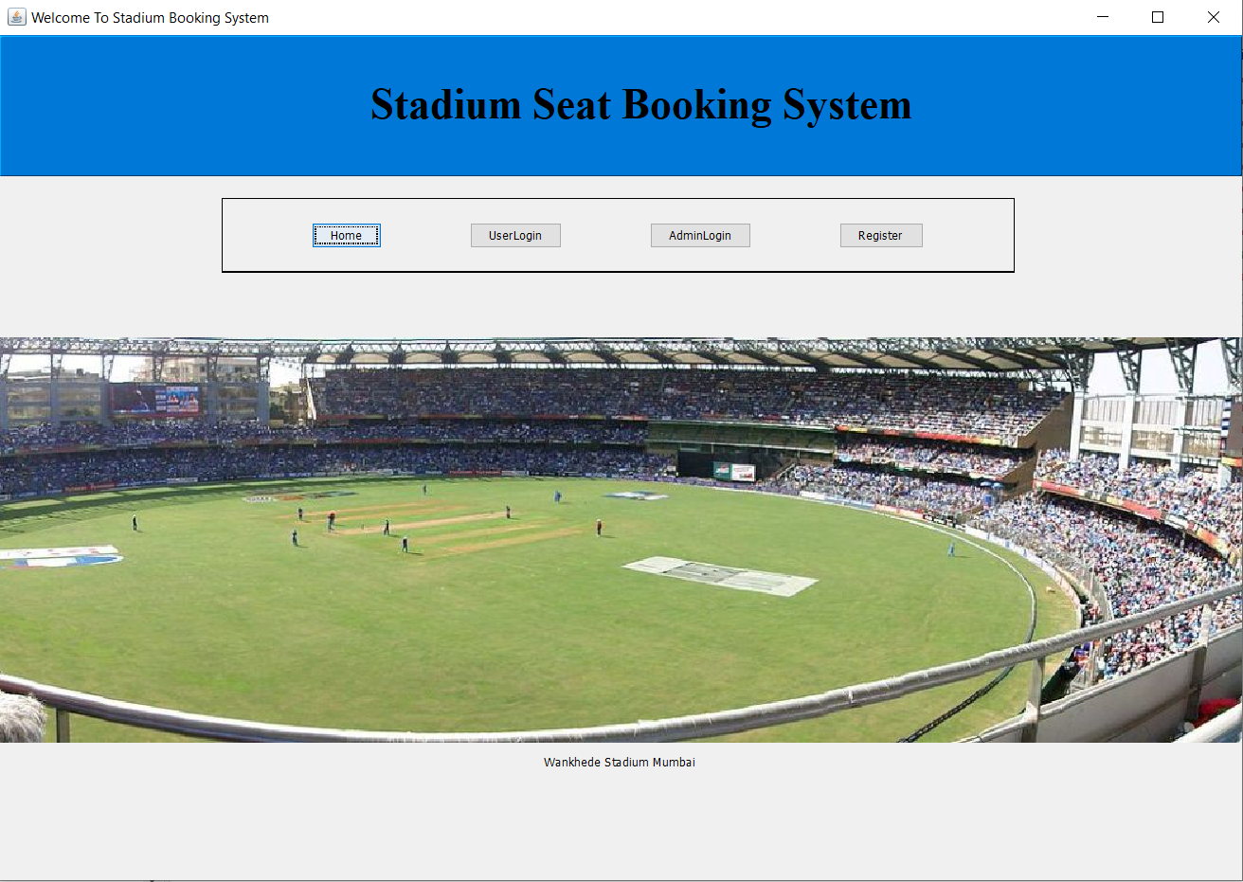
Results and Outputs
Home page

Slide 10
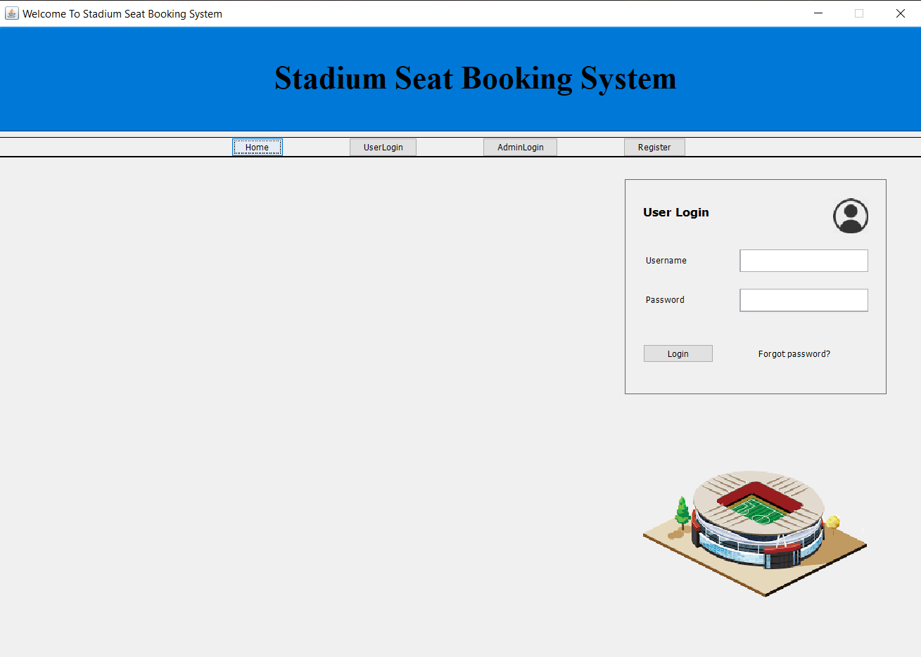
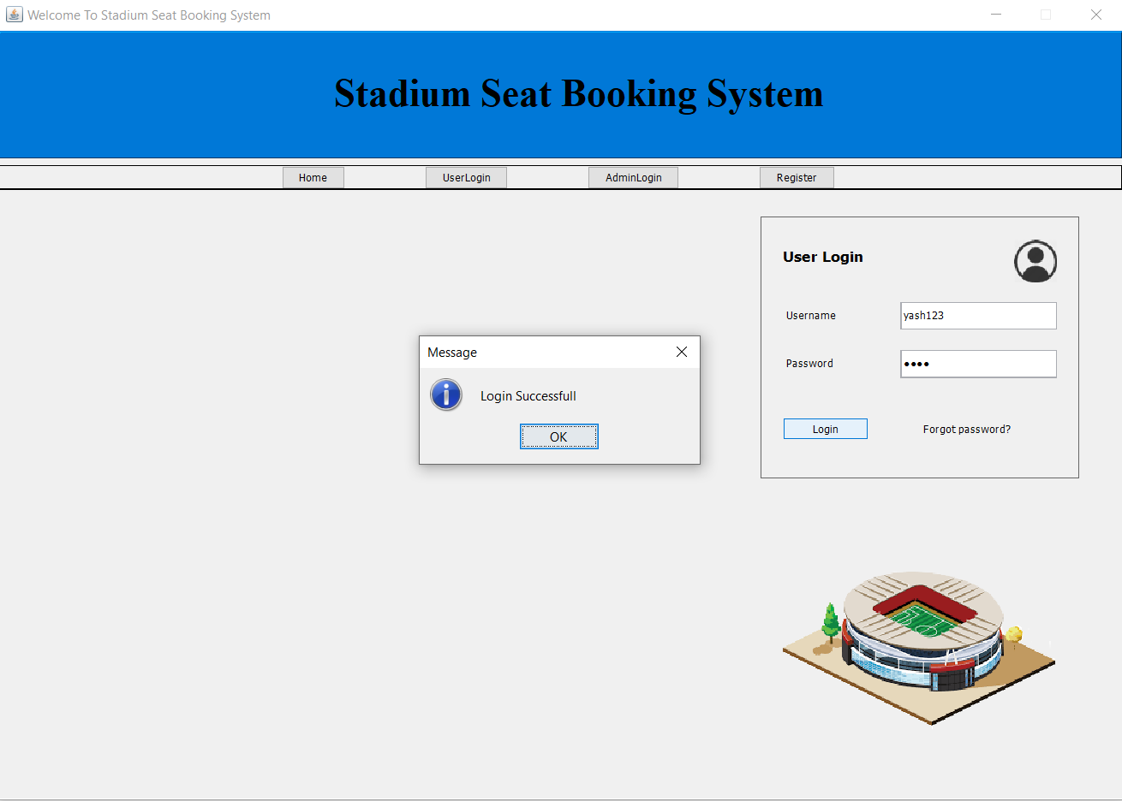
User Login

Slide 11
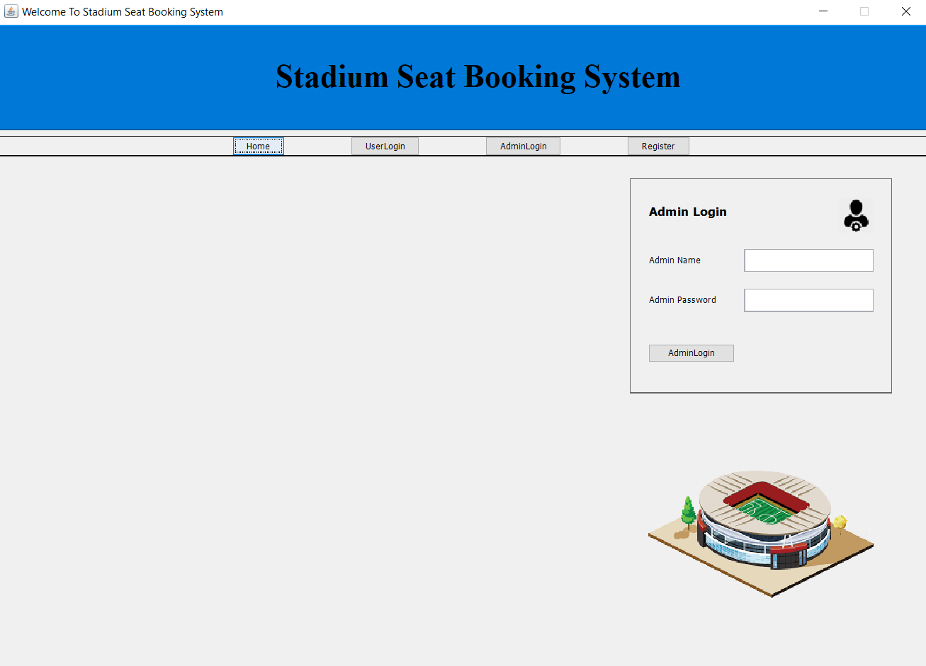
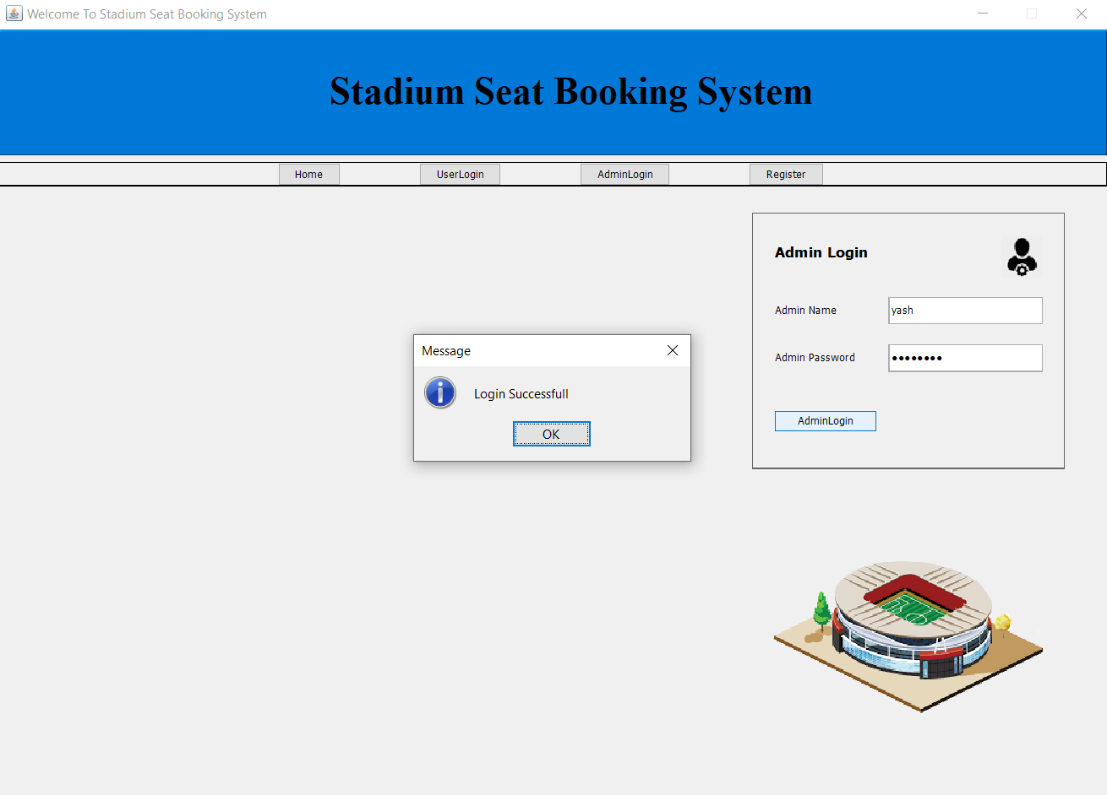
Admin Login

Slide 12
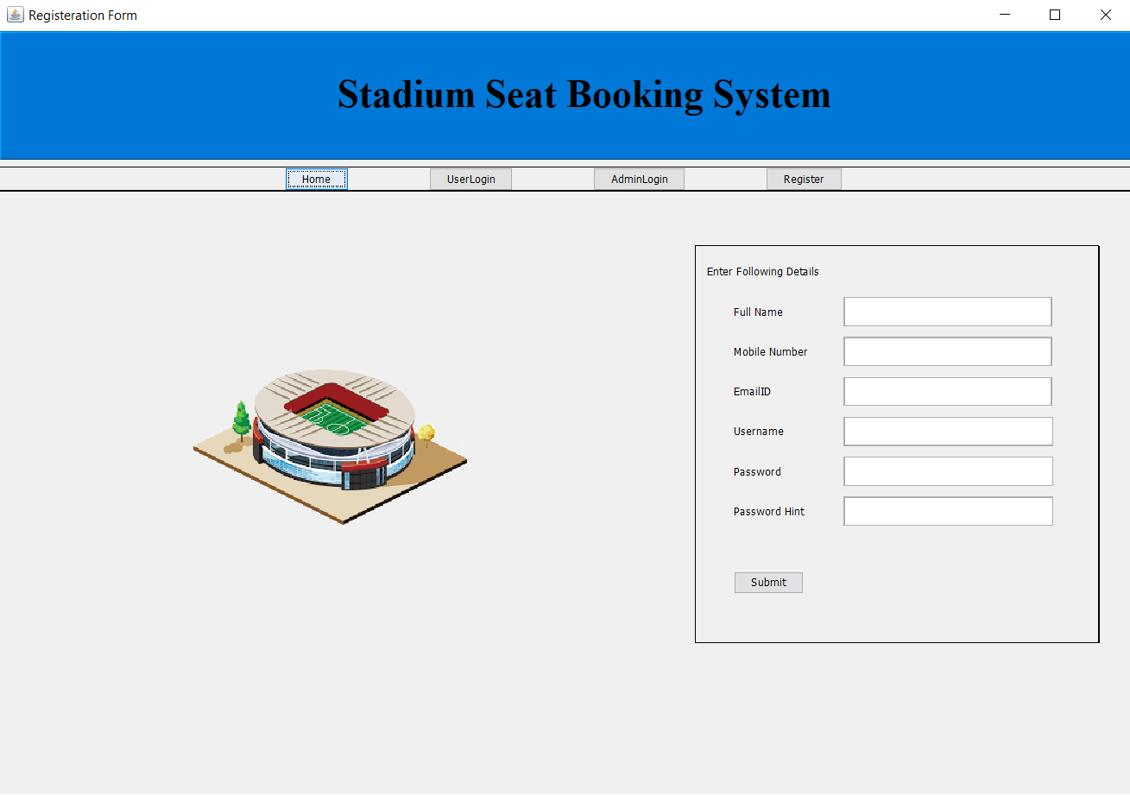
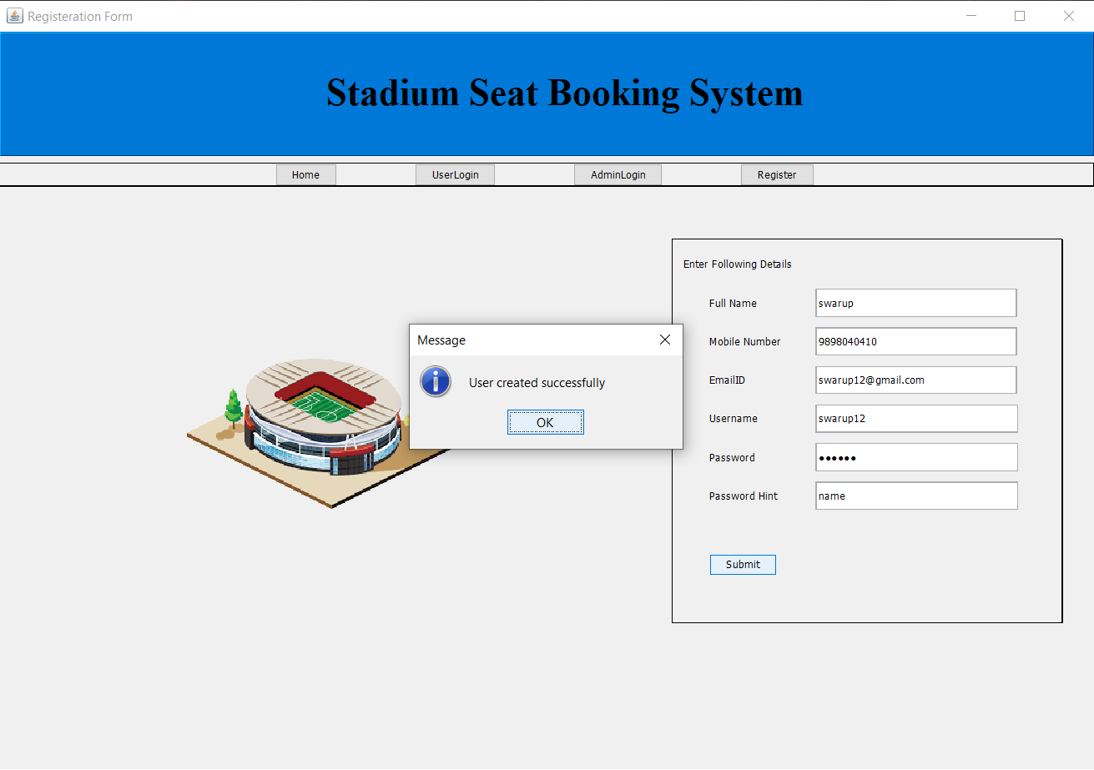
Register Page

Slide 13
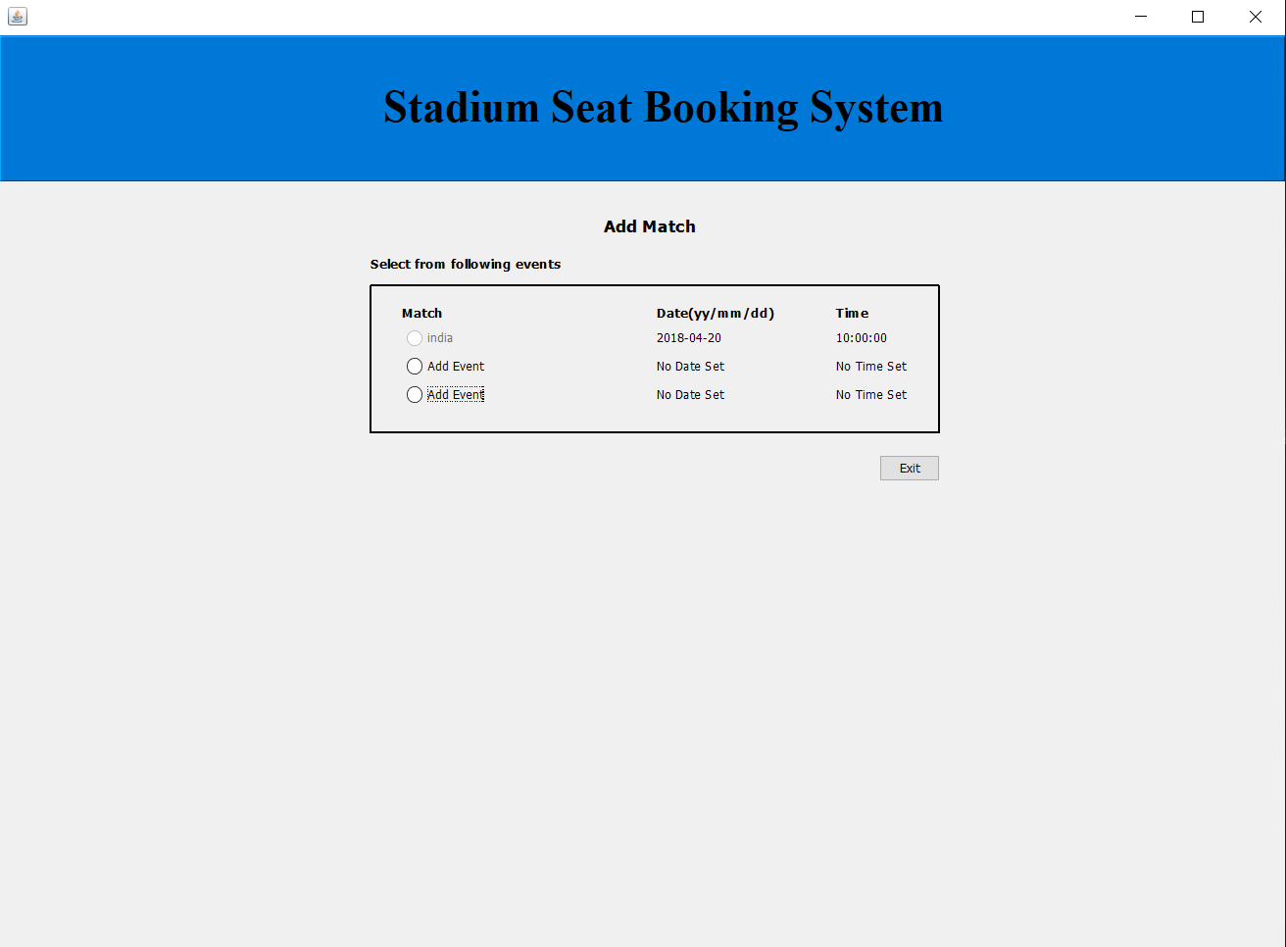
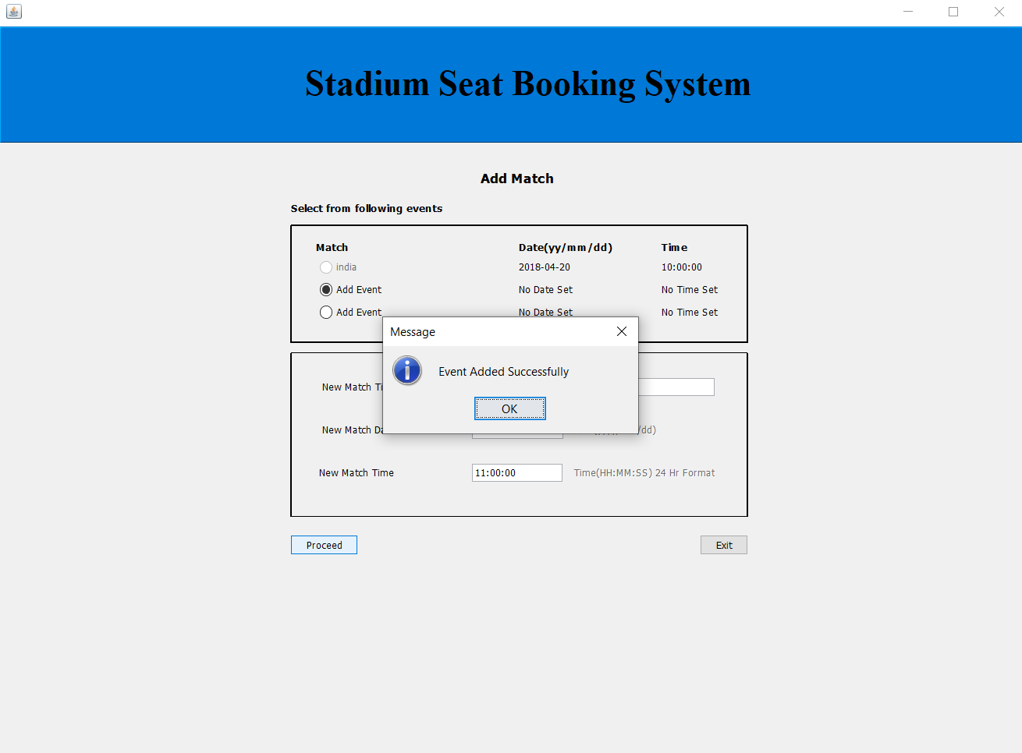
Add Match

Slide 14
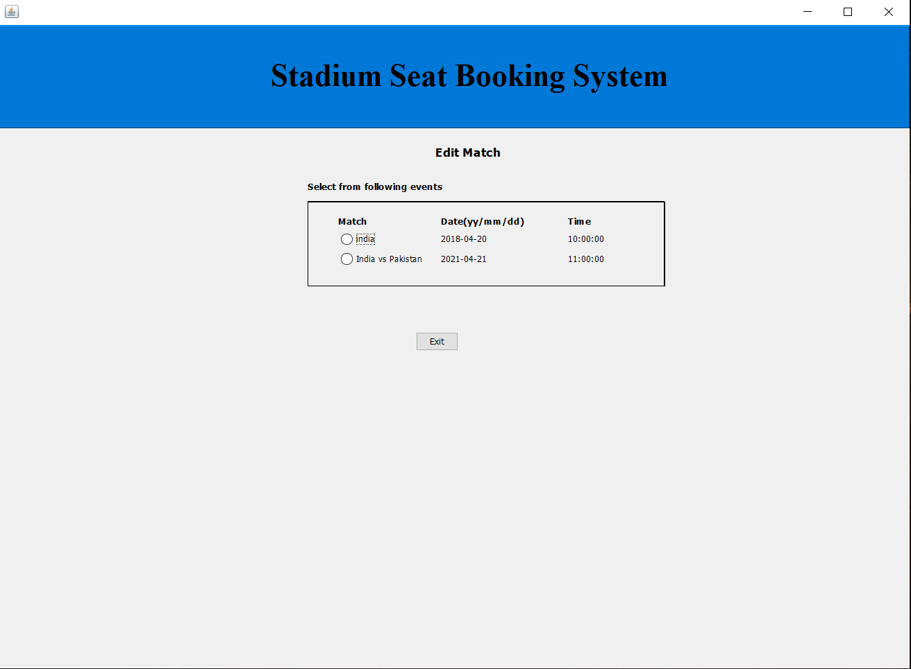
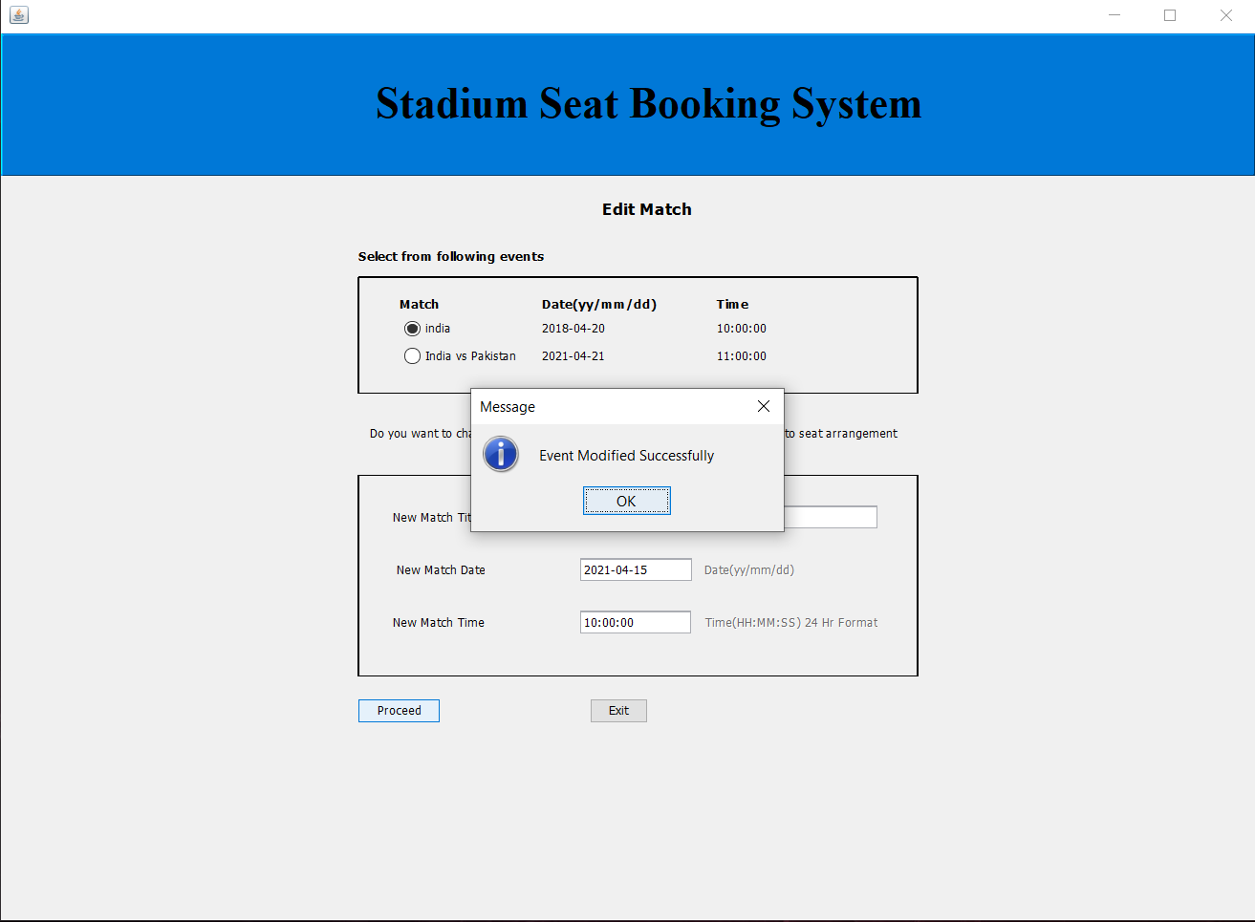
Edit Match

Slide 15
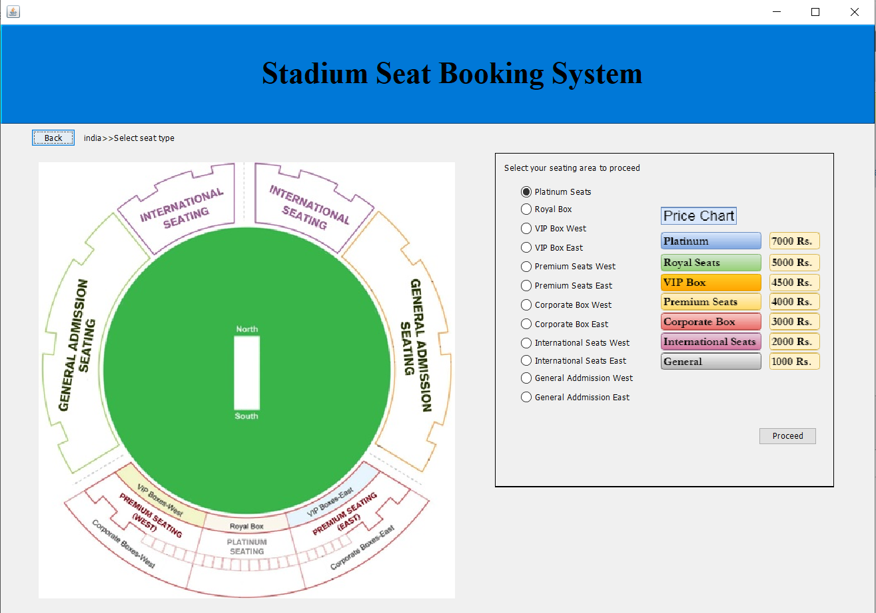
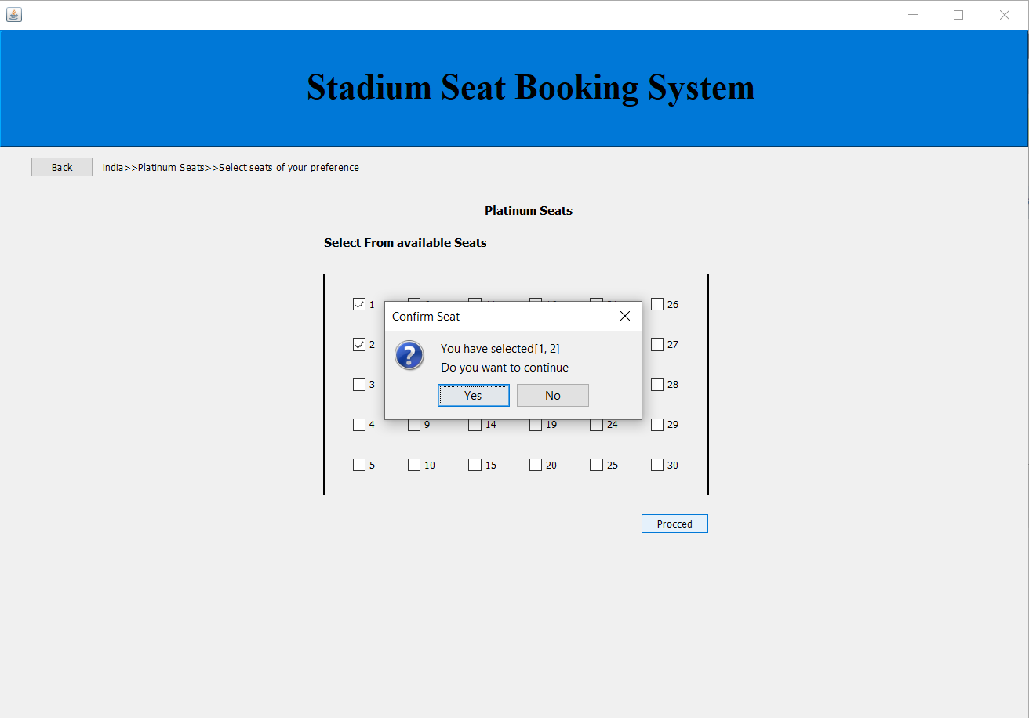
Seat Selection

Slide 16
Conclusion
In this project, we present the implementation of “Stadium seat Booking System”. This system is an effort to develop a software that can be accessed through the internet connection via computer.
Our project makes the seat booking simple and easy in this fast moving world as people dont want to waste there time for unecessary things like waiting in queue and can utilize this time to do some productive work.
So to make the entertainment easy for people and mostly equal to all people we made this project.
We also wanted to make thsi technology User friendly to people so they can use it without any prior training.

Slide 17
Future Scope
The system uses desktop application to book a stadium seat. The future work for this project is to create an application for smart phone (Android, iOS) operating system which is easy for user and a web-based application.
This project will be available an open source code, so that with the help of everyone we can improve it and make it more easy to use.
As we are progressing towards a digital world, people in the future will be able to completely book their tickets from this online platform, rather than going to the stadium and buy the ticket.
Encrypting (SHA -256,HTTPS,SSL,md5) of information and ticket fees through effective monitoring.

Slide 18
References
Eklund, S. and K. Pessi, 2001. Exploring mobile ecommerce in geographical bound retailing. Proceedings of the 34th Hawaii International Conference on System Sciences, Jan. 3-6, Piscataway, New Jersey, pp: 8035-8035.
Giancarlo, L., 2000. Types of e-commerce: B2B, B2C, C2C, C2B. Retrieved from http://gandalf.it/offline/off26-en.htm
Choi, S.Y., D.O. Stahl and A.B. Whinston, 1997. The Economics of Electronic Commerce. Macmillan Publisher, India. 852 | www.ijar.lit.az INTERNATIONAL JOURNAL Of ACADEMIC RESEARCH Vol. 3. No.1. January, 2011, Part III

